Slide 1
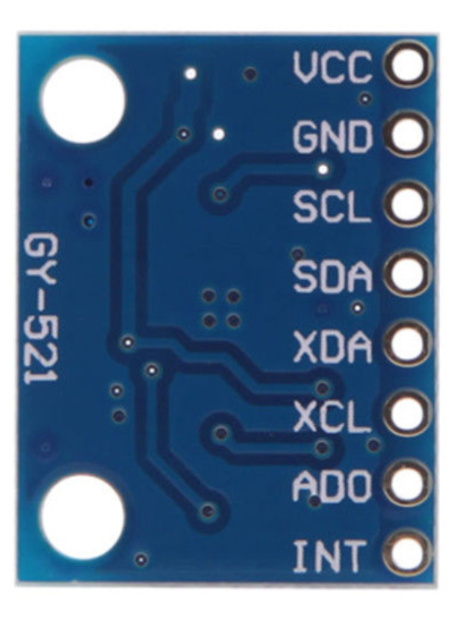
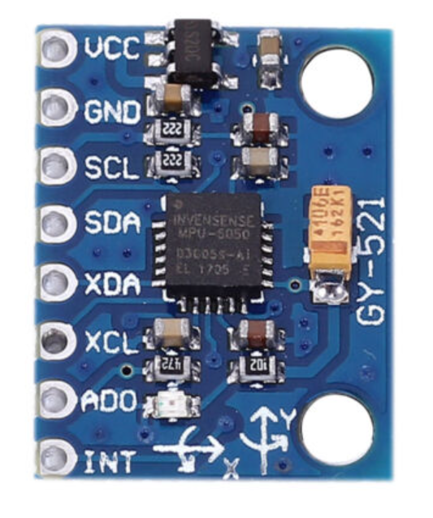
IMU SENSOR
Yuchen Xia
Haibo Zhao

Slide 2

Introduction
Name: MPU-6050(GY-521)
Manufacturer : InvenSense
Features:
(a). MPU6050 6-axis Accelerometer Gyroscope Sensor
(b).Communication mode: standard IIC communication protocol
(c).Chip built-in 16bit AD converter, 16bit data output
(d).Gyroscopes range: +/- 250 500 1000 2000 degree/sec
(e).Acceleration range: ±2 ±4 ±8 ±16g

Slide 3
What is in an IMU?
• Gyroscopes: Angular Velocity (radians/s)
• Accelerometer: Linear Acceleration (m/s2 or g)
• Magnetometer: Magnetic field strength (microTesla or Gauss)

Slide 4
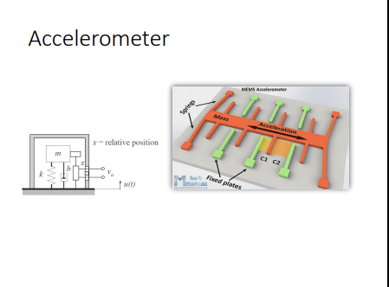
accelerator
By virtue of Newton’s second law (F = ma) a sensor may be made to sense acceleration by simply measuring the force on a mass.
At rest, acceleration is zero and the force on the mass is zero.
At any acceleration a, the force on the mass is directly proportional given a fixed mass.
This force may be sensed with any method of sensing force but,
The strain gauge is representative of direct force measurement.
Magnetic methods and electrostatic (capacitive) methods are quite commonly used.
The distance between the mass and a fixed surface, which depends on acceleration can be made into a capacitor. Capacitance increases (or decreases) with acceleration.
A magnetic sensor can be used by measuring the field of a magnetic mass. The higher the acceleration, the closer (or farther) the magnet from a fixed surface and hence the larger or lower the magnetic field.
The methods used in last lecture to sense position or proximity can now be used to sense acceleration.

Slide 5
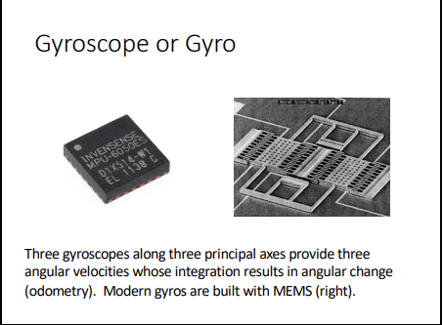
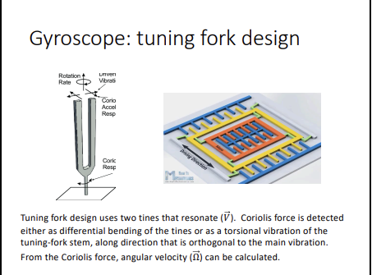
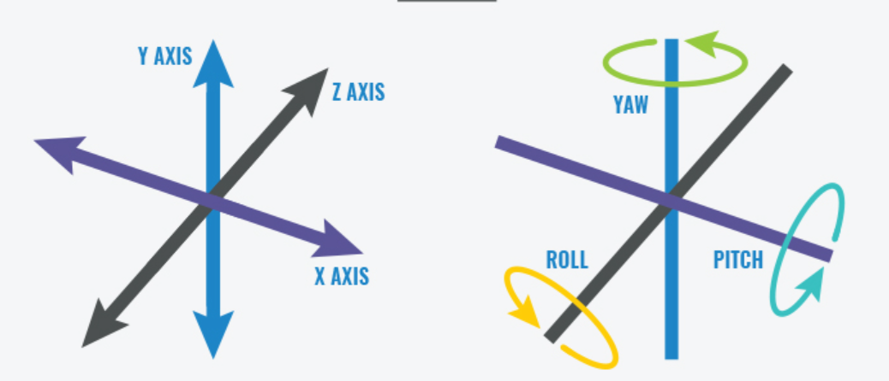
Gyroscopes
While accelerometers can measure linear acceleration, they can’t measure twisting or rotational movement. Gyroscopes, however, measure angular velocity about three axes: pitch (x axis), roll (y axis) and yaw (z axis). When integrated with sensor fusion software, a gyro can be used to determine an object’s orientation within 3D space.

Slide 6
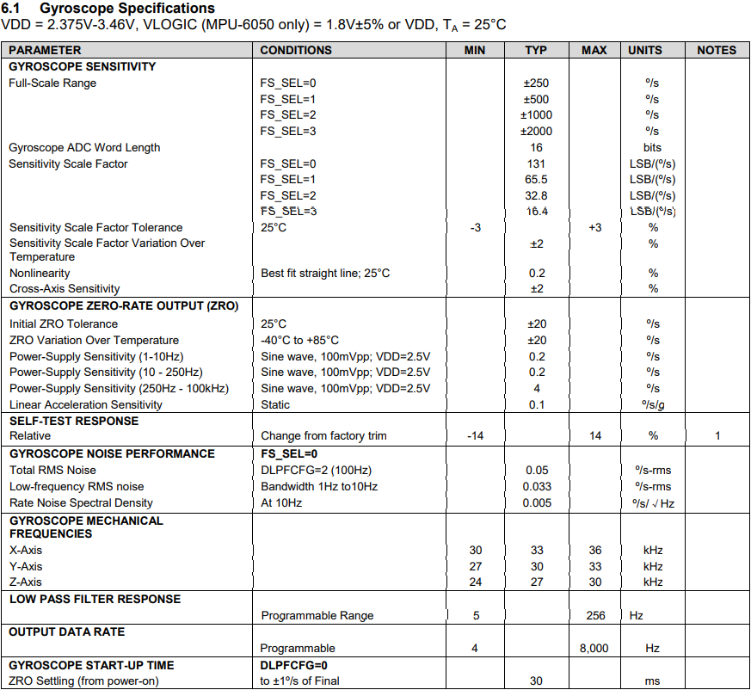
Datasheet

Slide 7
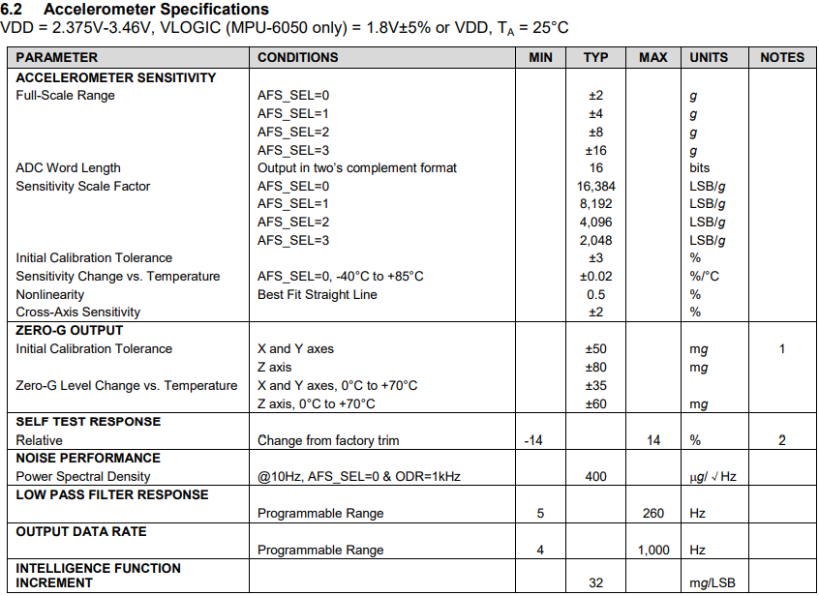
Datasheet

Slide 8
Range
Digital-output triple-axis accelerometer with a programmable full scale range of ±2g, ±4g, ±8g and ±16g.
Digital-output X-, Y-, and Z-Axis angular rate sensors (gyroscopes) with a user-programmable full scale range of ±250 °/sec, ±500 °/sec, ±1000 °/sec, and ±2000°/sec.
Since the sensitivity of the sensor will decrease with the increase of the range, we chose ±2g for the accelerometer and ±250°/sec for the gyroscope for this measurement.

Slide 9
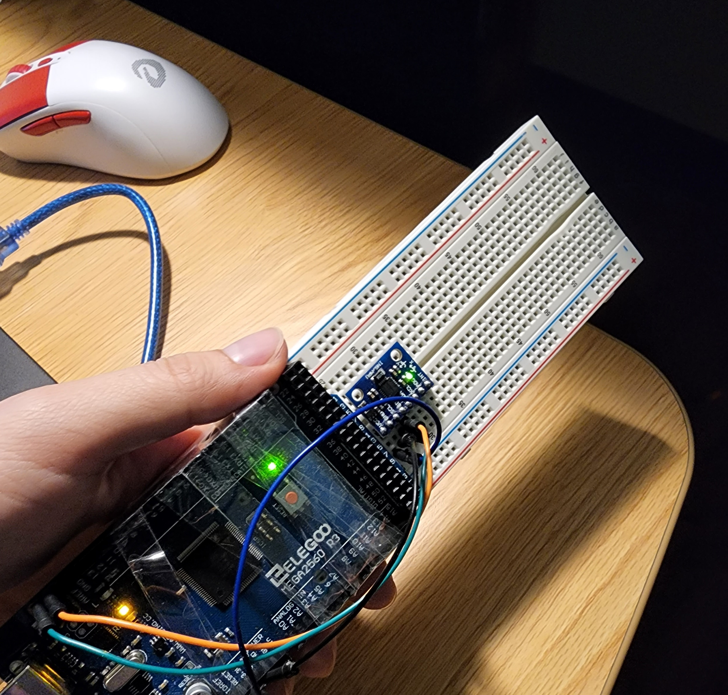
Test plan
We need to measure the angular velocity range of the gyroscope, and the acceleration of the accelerometer. Our test plan is very straight forward, rotate or toss the sensor by hand to measure its maximum measurement range.

Slide 10
Findings
The test result looks good

Slide 11
Accuracy
Test plan :For the gyroscope, fix the IUM sensor on the breadboard, and connect a rotary encoder under it to measure the angular velocity of the rotating breadboard, and analyze the error by comparing the reading with the IMU sensor. For an accelerometer, the acceleration can be obtained by further deriving the angular velocity with respect to time t.

Slide 12
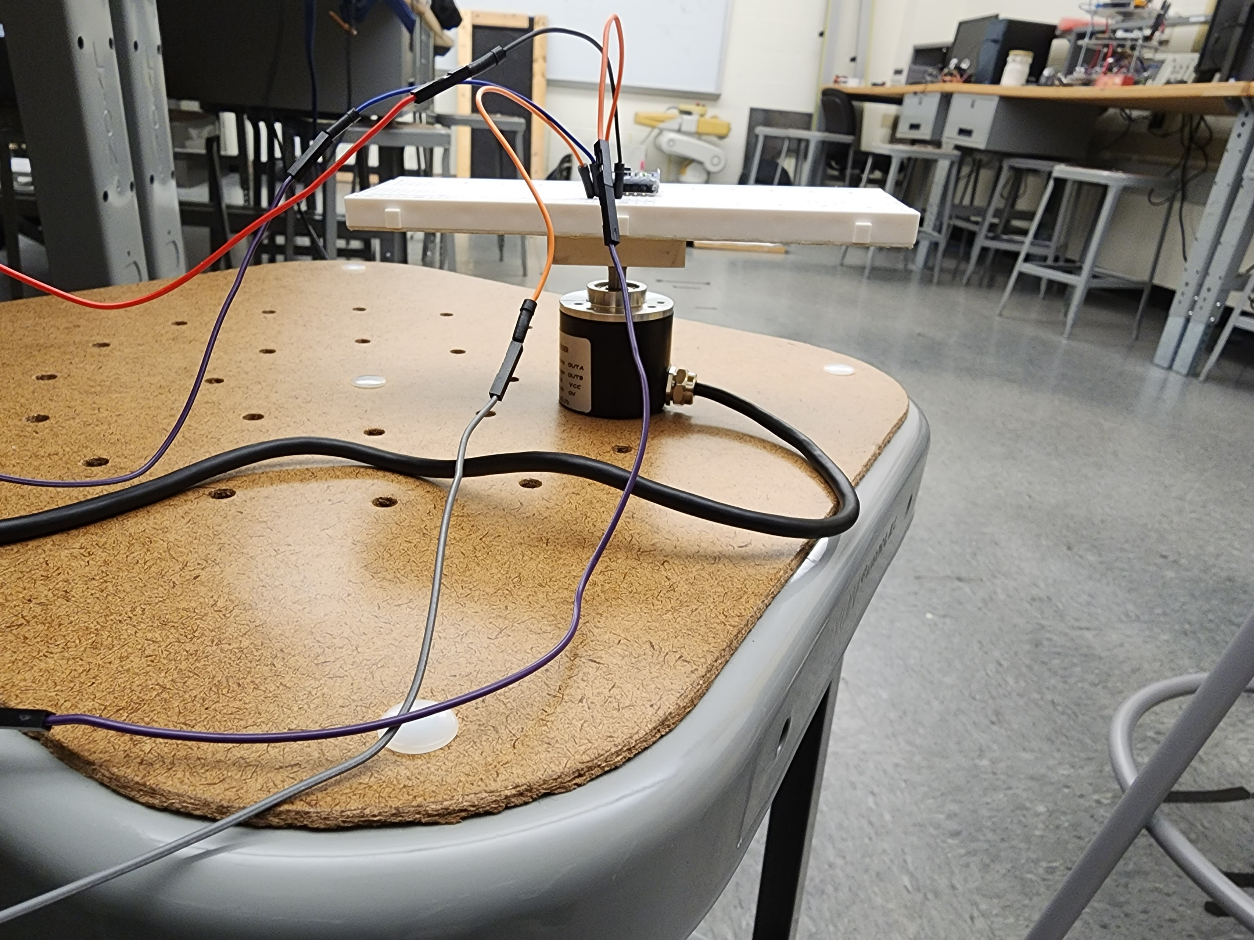
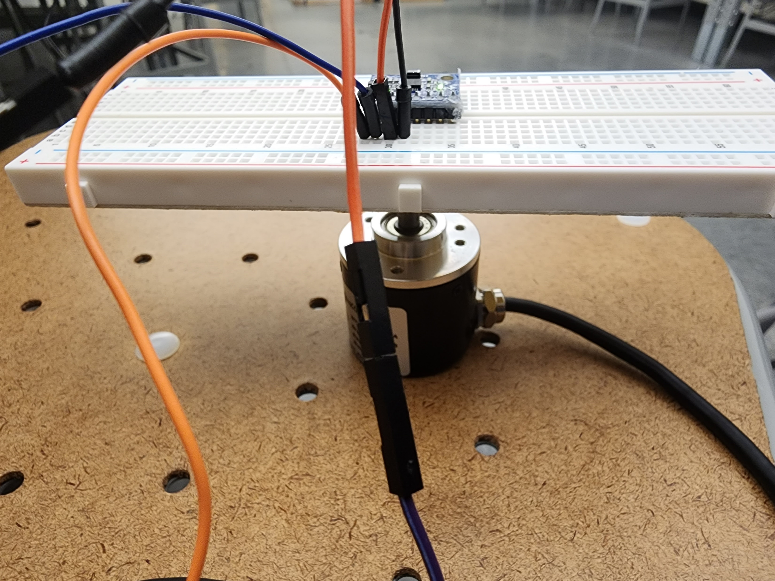
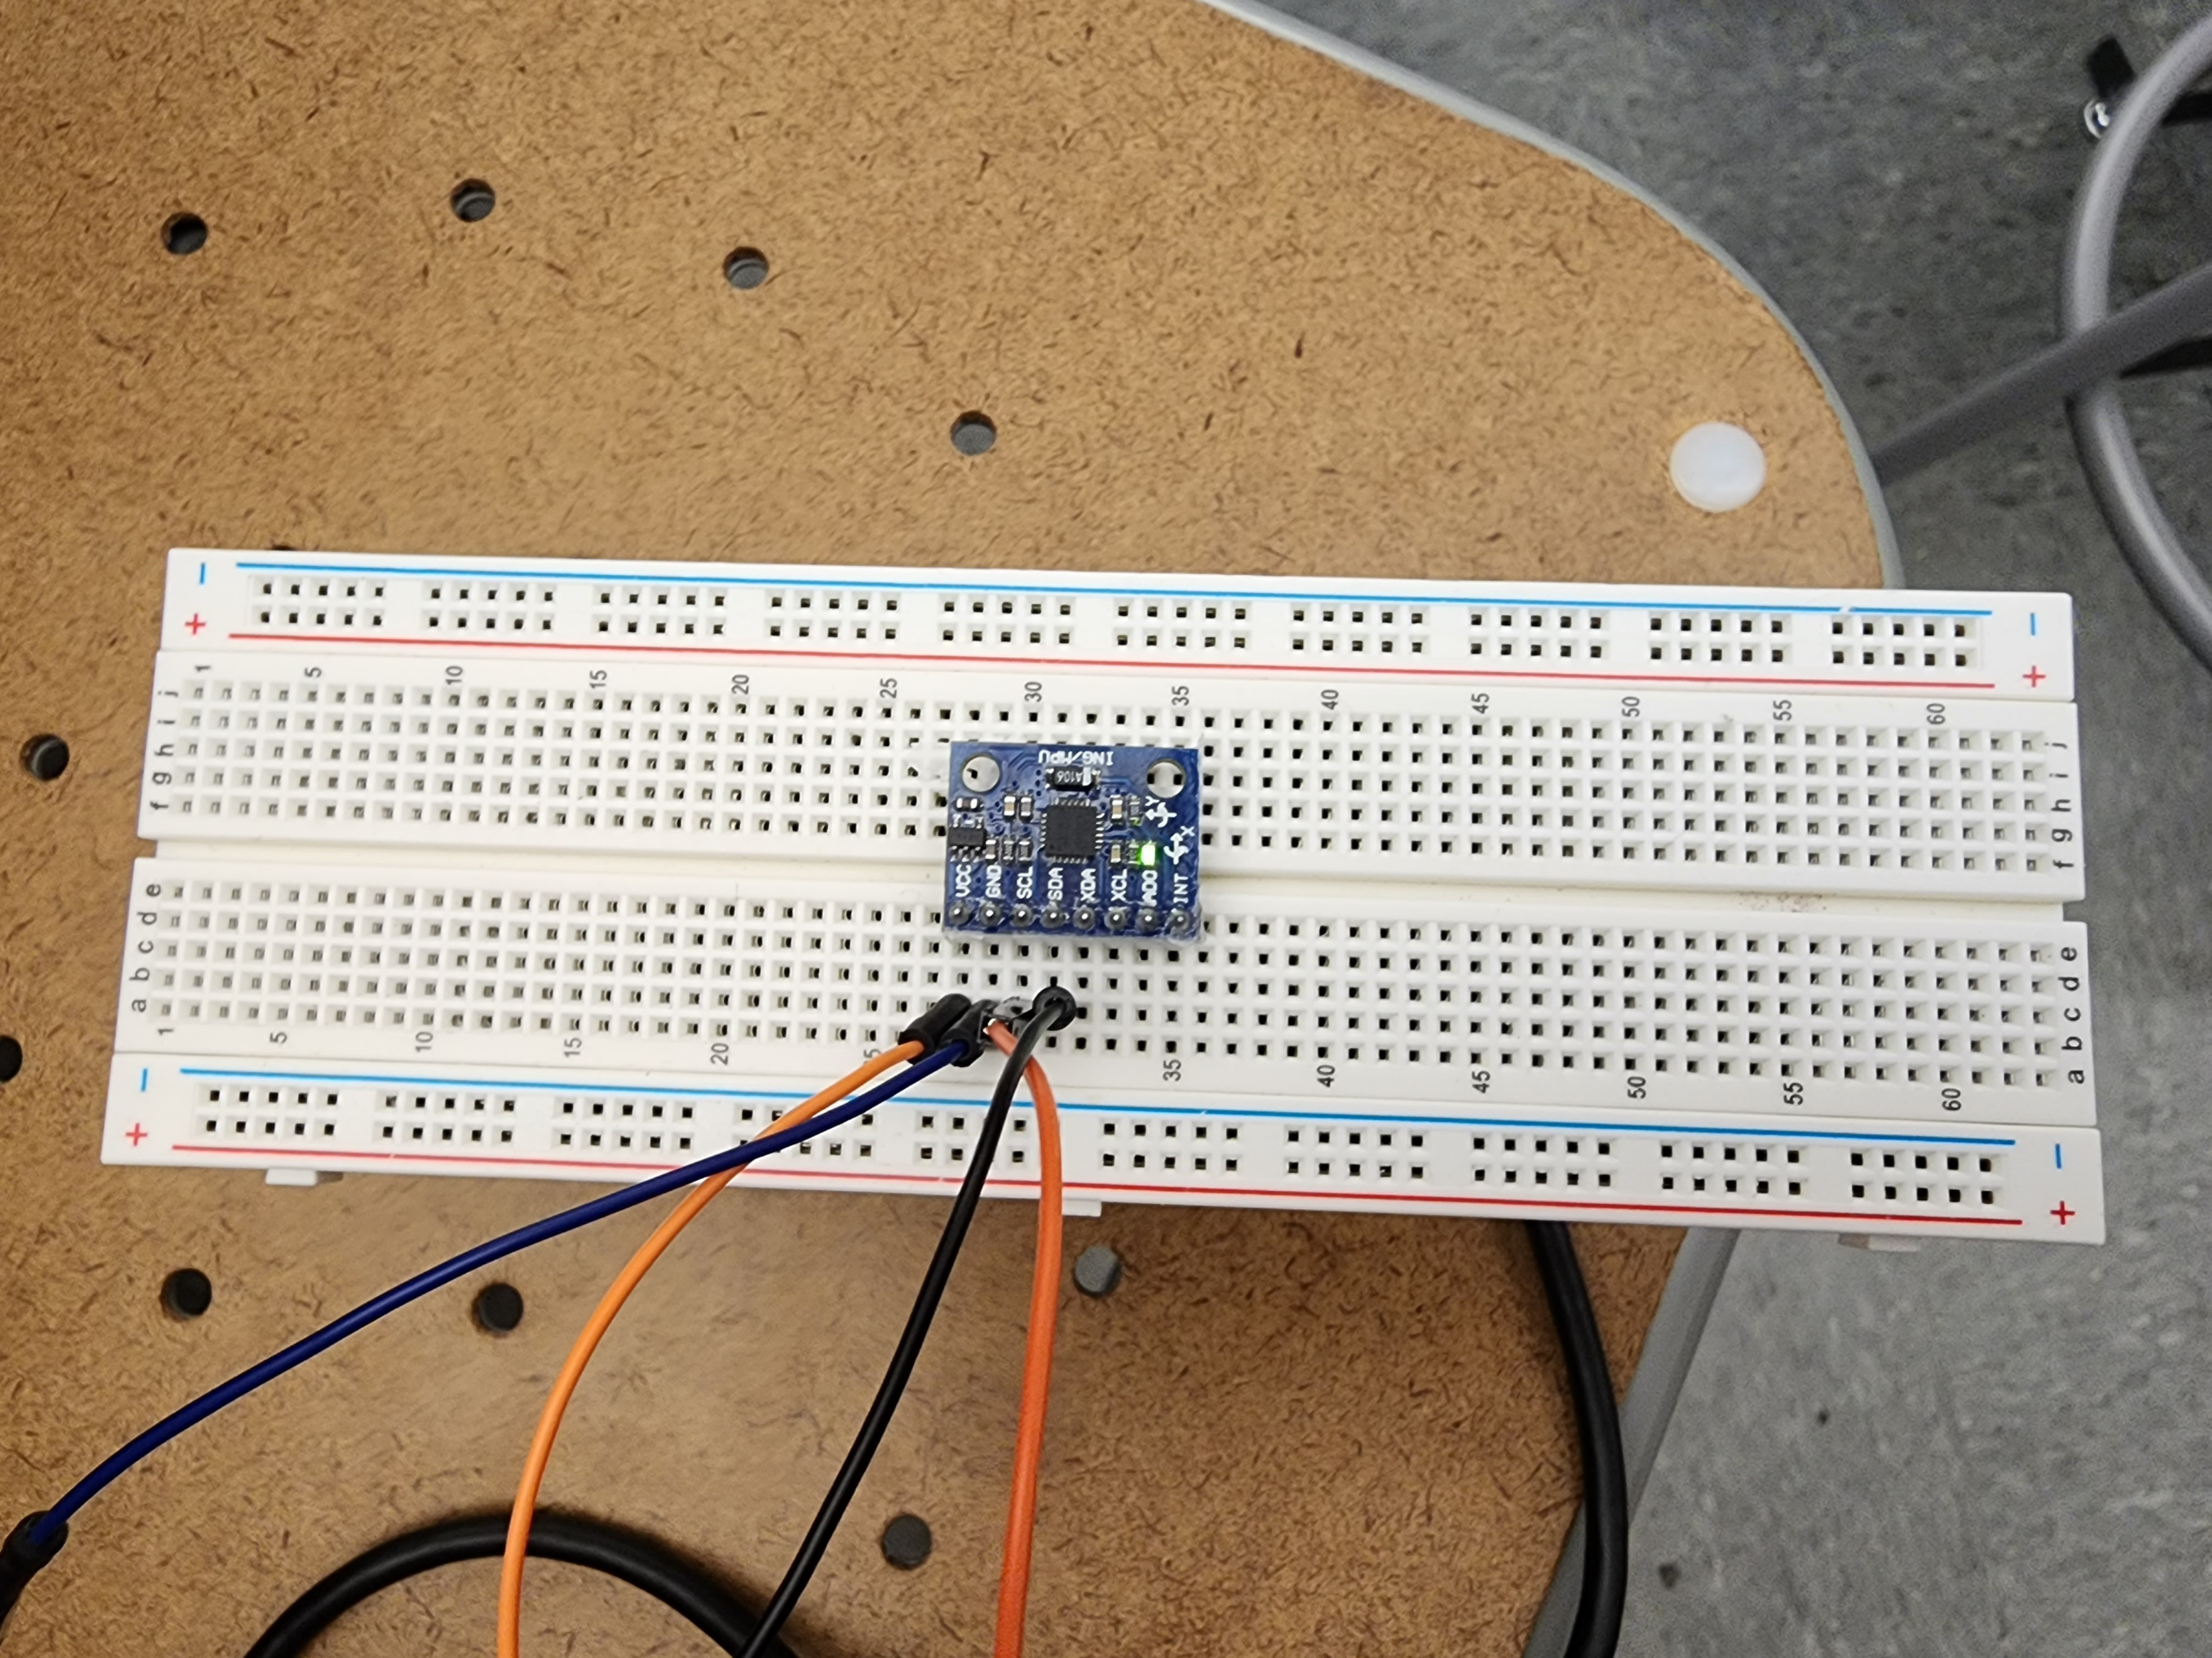
operation
We measure the data by rotating the breadboard about 360 degrees.

Slide 13
Gyroscopes
X-angular | IMU1 | TRUE1 | IMU2 | TRUE2 | IMU3 | TRUE3
average | 144.5923 | 147.015 | 189.4419 | 205.175 | 201.2956 | 209.6681
Percent error | -1.65% |  | -7.67% |  | -3.99%
Z-angular | IMU1 | TRUE1 | IMU2 | TRUE2 | IMU3 | TRUE3
average | 153.94 | 186.9581 | 142.3384 | 178.1926 | 117.1111 | 118.7393
Percent error | -17.66% |  | -20.12% |  | -1.37%
Y-angular | IMU1 | TRUE1 | IMU2 | TRUE2 | IMU3 | TRUE3
average | 129.6429 | 145.4154 | 186.5878 | 200.64 | 172.8174 | 200.77
Percent error | -10.85% |  | -7.00% |  | -13.92%

Slide 14
Accelerator
X-acc | IMU1 | TRUE1 | IMU2 | TRUE2 | IMU3 | TRUE3
average | 1.012273 | 0.577273 | 1.026316 | 0.621053 | 1.046154 | 0.984615
Percent error | 75.35% |  | 65.25% |  | 6.25%
Y-acc | IMU1 | TRUE1 | IMU2 | TRUE2 | IMU3 | TRUE3
average | 0.997059 | 0.623529 | 0.998889 | 0.640741 | 0.988077 | 0.602308
Percent error | 59.91% |  | 55.90% |  | 64.05%
Findings: Both gyroscopes and accelerator measurement results deviate greatly from the true ground. We speculate that it is due to the mismatch between the readings of the IMU sensor and the readings of the rotary encoder, resulting in data mismatch.
Z-acc | IMU1 | TRUE1 | IMU2 | TRUE2 | IMU3 | TRUE3
average | 0.899643 | 0.657143 | 0.897 | 0.585 | 0.884375 | 0.5625
Percent error | 36.90% |  | 53.33% |  | 57.22%

Slide 15
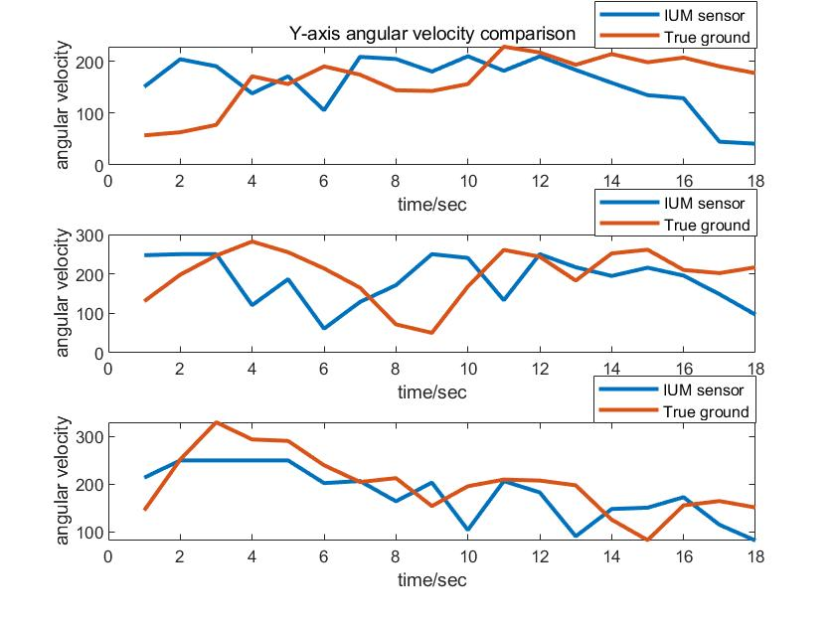
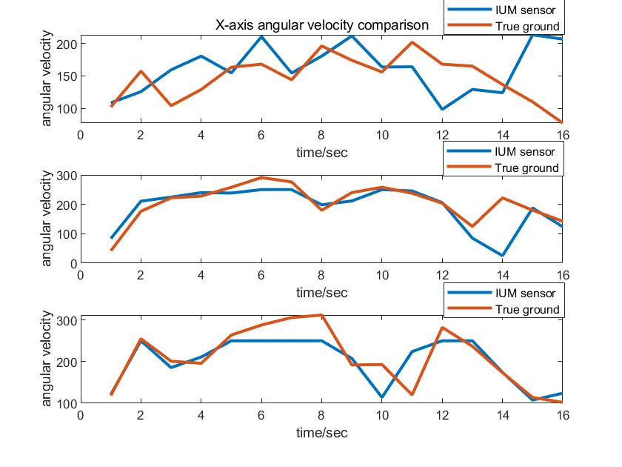
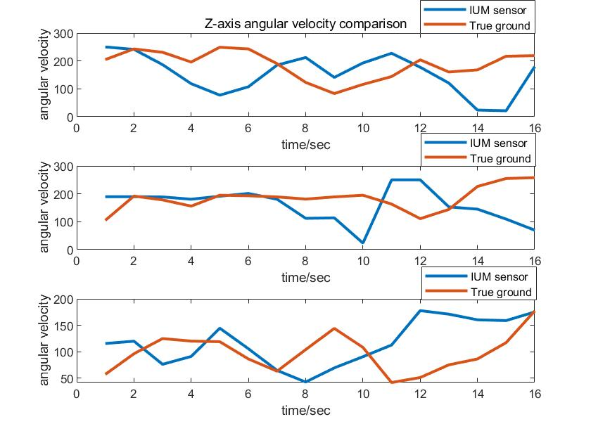
Gyroscopes Sensitivity
Findings: According to the data we obtained, using Matlab to draw and analyze the pictures, we found that the most data of gyroscope of IMU sensor has a linear relationship at the beginning, but the error will gradually increase if time keeps increases.

Slide 16
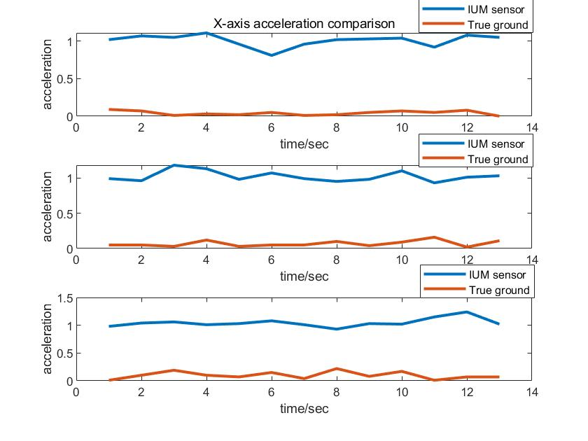
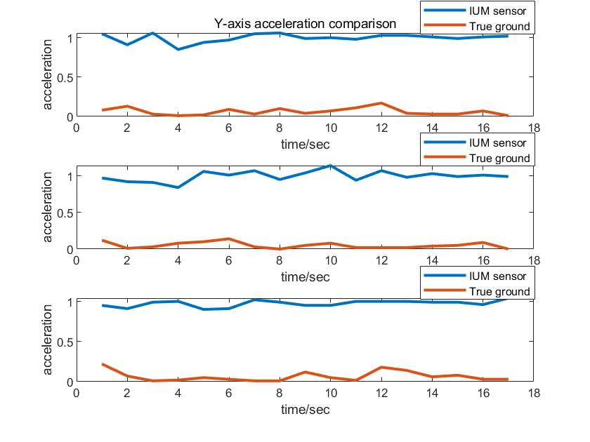
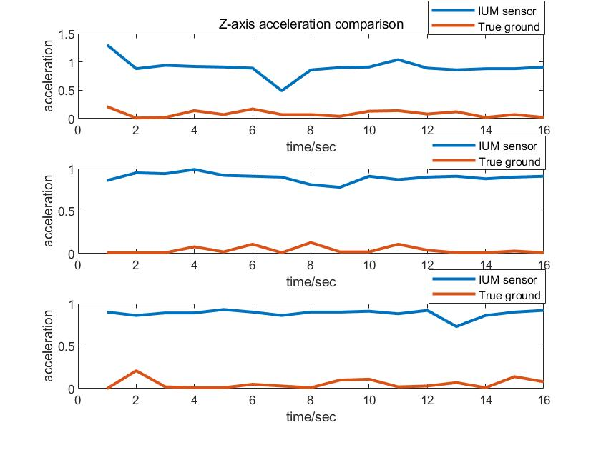
Accelerometer Sensitivity
Findings: We found that the error of the IMU sensor has a large deviation from the actual measurement value. We think this is caused by the defect of the IMU sensor itself, but the trend of the two lines is roughly the same, which should be reduced by modifying the parameters, but we fail to find a solution.

Slide 17
Conclusion
IMU uses gyroscopes to measure angular velocities and accelerometers to measure accelerations about the three axes.
Integration of angular velocity over a short time interval provides angular change.
Double integration of acceleration over a short time interval provides linear change.
IMU is inexpensive but requires calibration and is subject to ambient noise in environments.

